Slide 1
Department of Applied Mathematics and Computational Sciences
III Sem M.Sc.Software Systems
Transform Techniques
Dr. V. Suresh kumar

Slide 2
Existence of Laplace Transform

Slide 3
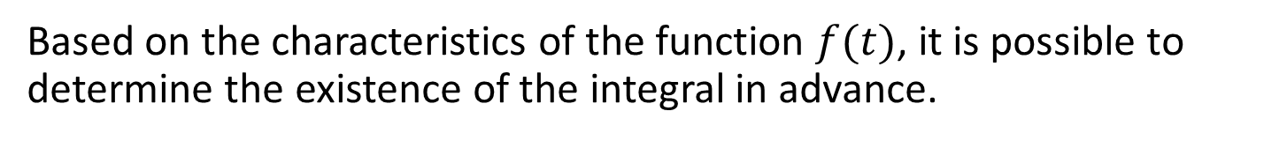
Does Laplace Transform exist for all functions?
No
For some functions Laplace transform does not exist.
If $\int_{0}^{∞}{e^{−st}f\left(t\right)dt<∞}$, then the Laplace transform exist.
But, It is not guaranteed that $\int_{0}^{∞}{e^{−st}f\left(t\right)dt<∞}$ for all $f(t)$.
Based on the characteristics of the function $f(t)$, it is possible to determine the existence of the integral in advance.

Slide 4




Exponential order
A function $f(t)$ is said of exponential order if there exists a constant $c$ and positive constants $t_{0}$ and $M$ such that $|f(t)|<Me^{ct}$, for all $t>t_{0}$ at which $f(t)$ is defined.
Graphical interpretation
$$Me^{ct}$$
$f(t$)
$$t_{0}$$
$$t$$

Slide 5

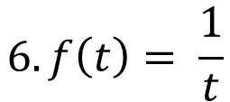




Examples
$$1. f\left(t\right)=t^{2}$$
Exponential order
$$6. f\left(t\right)= \frac{1}{t}$$
Exponential order
$$2. f\left(t\right)=sin⁡t$$
Exponential order
$$3. f\left(t\right)=\cos{t}$$
Exponential order
$$4. f\left(t\right)=e^{t^{2}}$$
Not exponential order
$$5. f\left(t\right)=\tan{t}$$
Not exponential order

Slide 6
Piecewise continuous function

Slide 7
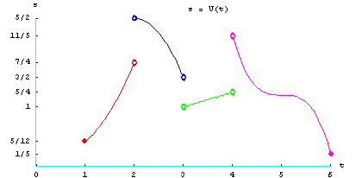
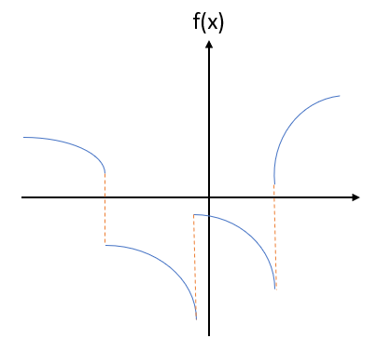
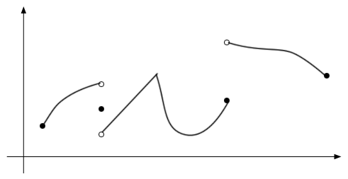


Graphical interpretation
$$f(x)$$
$$x$$

Slide 8
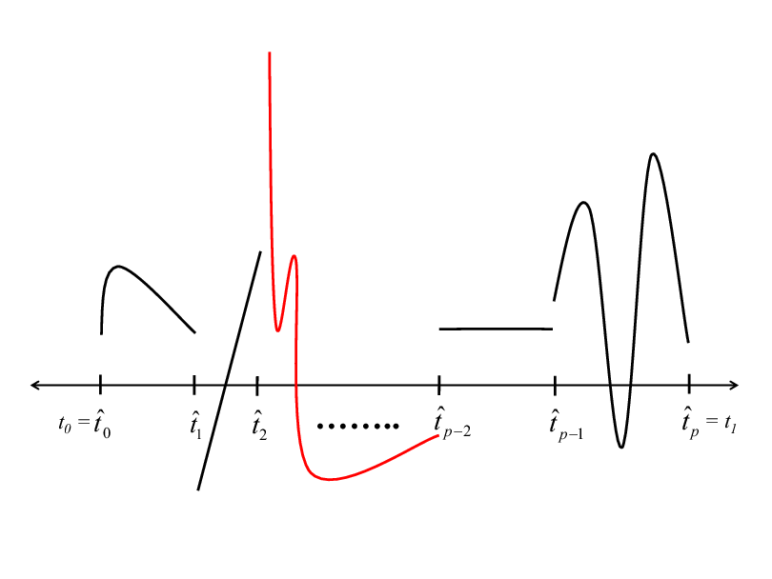
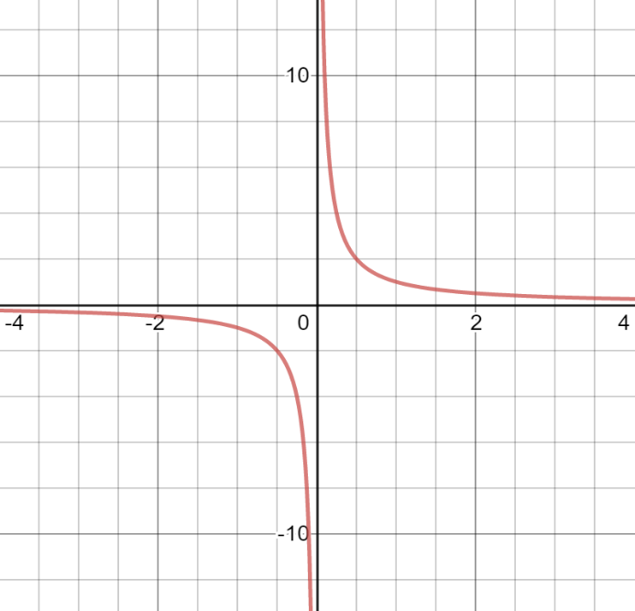
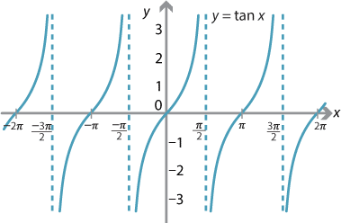
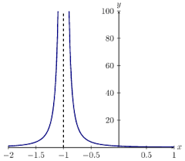
Not piecewise continuous

Slide 9
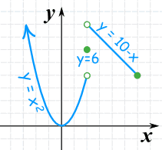
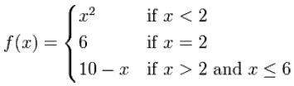
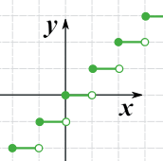
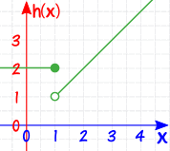


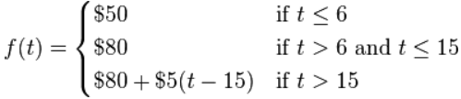
Examples

Slide 10
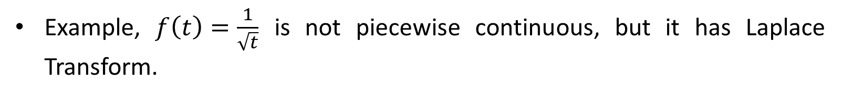
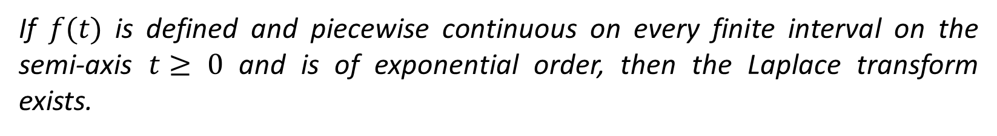
Existence Theorem for Laplace Transforms
If $f(t)$ is defined and piecewise continuous on every finite interval on the semi-axis $t≥ 0$ and is of exponential order, then the Laplace transform exists.
Note
A function which satisfies both the conditions will definitely have Laplace Transform.
This theorem is only a sufficient condition, not necessary.
A function which not satisfies any of these conditions will also have the Laplace Transform.
Example, $f\left(t\right)=\frac{1}{\sqrt{t}}$ is not piecewise continuous, but it has Laplace Transform.

Slide 11


